Slide 1


Abstra
Lazar Milicevic
Weekly support report
Support, Challenges, Sollutions
29.04.2025

Slide 2
Agenda
1. Zendesk Ticket Management & Optimization
3. Reported & Tracked Issues
5. Next Steps
2. Infra & Product Coordination
4. Visual & Helpdesk Improvements
6. Q&A

Slide 3

Zendesk Support & Performance Update
Customer success: Weekly Support Report – 29.04.2025
What was done:
✅ Created dedicated Zendesk view to track K signups, allowing us to monitor which users signed up and later approve them in Cognito
✅ Handled onboarding for Ness Tchenio and Emilie Boissady
– Created accounts, assigned Agent roles
– Scheduled onboarding sessions and presented key Zendesk features, workflows, and internal processes
✅ Scheduled/rescheduled sessions based on user availability
✅ Processed onboarding request for 2 CHUV external users
– Collected full access data (name, email, institution, VPN & WiFi IPs)
– Sent request for IP whitelisting and account creation
– Confirmed successful Abstra access
– Planned onboarding session and coordinated SageMaker intro support
✅ Preparing dedicated Zendesk macros for onboarding Owkin K users (to automate welcome/follow-up communication)
Ongoing focus: More automation, faster support response times, and better tracking of K users

Slide 4
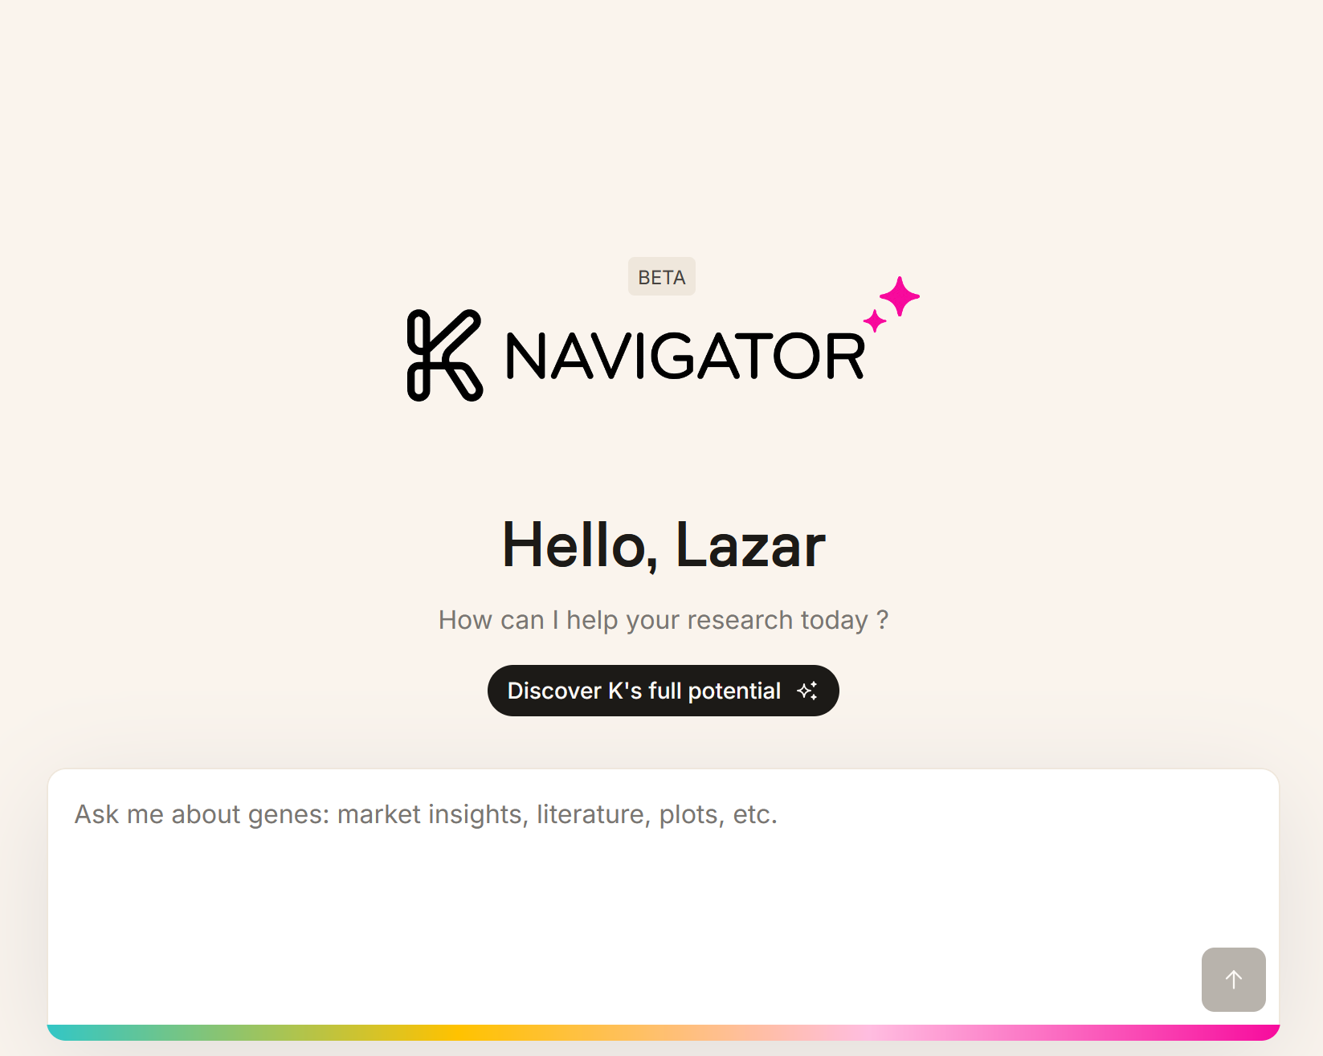
Infra & Product Coordination
Customer success: Weekly Support Report – 29.04.2025
Where we are now ?
✅ Cordinated external user onboarding (CHUV)
✅ After approving account in Cognito, manually notified Owkin K users by email due to lack of automated confirmation.
✅ Supported SurveySparrow survey request
– Provided direct public link to the existing NPS survey
– Confirmed no login is needed
– Verified that responses are consolidated with widget-based submissions
✅ Working on the detecting different Owkin K issues, and reporting them.

Slide 5
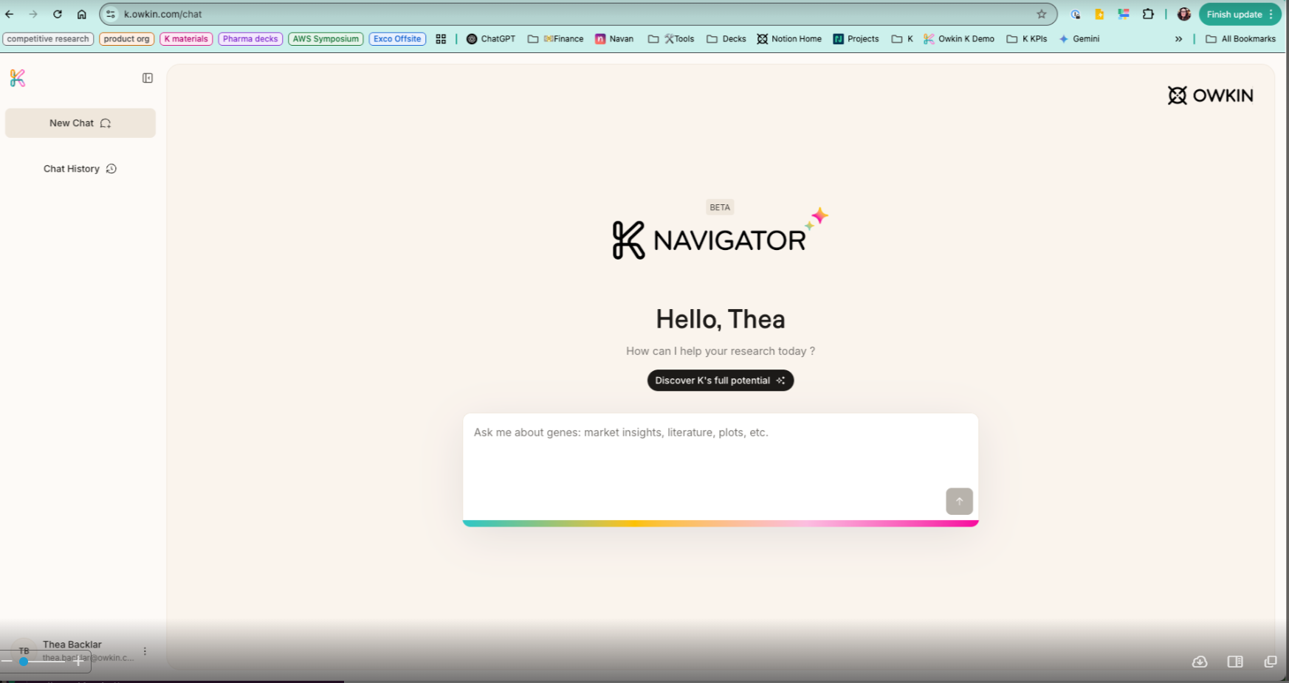
Reported & Tracked Issues
Customer success: Weekly Support Report – 29.04.2025
Some of them:
✅ Investigated issue reported by Thea related to SurveySparrow widget visibility
– Widget was visible on my side
– Suggested clearing browser cache or using an alternate browser
– Still under investigation; Linear ticket will be created today
✅ Collected screenshots, logs and planned further reporting via Linear and to Jeremy

Slide 6

Visual & Helpdesk
Customer success: Weekly Support Report – 29.04.2025
✅ Two Zendesk onboarding sessions completed
– Presented Zendesk features, support process, and internal tools
✅ Created Zendesk view for Owkin K signups tracking
– To support easier Cognito approvals
✅ Validated dataset access for Hackathon participants
– Confirmed access in Abstra for all three teams
✅ Supported and follow-up on additional datasets which they required.

Slide 7
Next Steps
Customer success: Weekly Support Report – 29.04.2025
?
Monitor FullStory dashboard and review filters
Create Linear ticket for Thea's feedback visibility issue
Finalize Zendesk macros for Owkin K onboarding process
Continue to support dataset access validation and CHUV user onboarding
Continue investigation of Owkin K UI issues and coordination with product team
Work on the Monthly Support Report for April during the upcoming days

Slide 8

Q&A
Customer success: Weekly Support Report – 29.04.2025
?

Slide 9
Thank you!

